Slide 1


Slide 2
Detection of Acral Lentiginous Melanoma Using Dermoscopic Images
Presented By:
Fatima Zulfiqar CIIT/SP20-RCS-005/LHR
Rehan Raza CIIT/SP20-RCS-018/LHR
Course Instructor: Dr. M. Aksam Iftikhar

Slide 3
INTRODUCTION
1

Slide 4
Melanoma
Melanoma is also known as malignant melanoma
A type of skin cancer
Develops from the pigment-producing cells
known as melanocytes
25% of Melanoma is developed from moles
In Females, they most commonly occur on legs
In Males, they commonly occurs on the back

Slide 5
Melanoma - types
Superficial spreading melanoma
Nodular melanoma
Lentigo maligna melanoma
Acral lentiginous melanoma

Slide 6
Acral Lentiginous Melanoma
Occurrence of Acral Lentiginous Melanoma
Palms
Infected Rate
1 to 3% of melanomas in Australia and New Zealand are acral lentiginous melanoma
Soles
Beneath the Nails
29-72% of melanoma in dark-skinned individuals
Less than 1% of melanoma in fair-skinned people

Slide 7
Acral Lentiginous Melanoma
Acral Lentiginous Melanoma- Characteristics
Large size: >6 mm and often several centimeters or more in diameter at diagnosis
Variable pigmentation: most often a mixture of brown, and blue-grey, black and red colors
A smooth surface at first, later becoming thicker with an irregular surface that may be dry or warty
Ulceration or bleeding

Slide 8
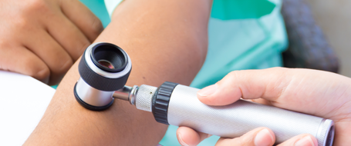
Acral Lentiginous Melanoma - Diagnosis Techniques
Melanoma diagnosis techniques
Pathology Report
Biopsy
Dermoscopy

Slide 9
Motivations
1
To reduce death rate due to skin cancer
2
Diagnosis of Acral Lentigunous Melanoma at early stage
3
Help Dermatologist to diagnose Acral Lentigunous Melanoma in terms of accuracy and speed

Slide 10
Objective
To implement a technique in which Acral Lentiginous Melanoma can automatically be detected from Dermoscopic Images

Slide 11
LITERATURE REVIEW
2

Slide 12
Literature Review
Related Work | Proposed Technique | Results
C. Yu et al [1] | Data Augmentation and Transfer Learning Using Pre-trained VGG16 | Accuracy : 80.3% Sensitivity : 92% Specificity : 75%
S. Lee et al [2] | Transfer Learning using Pre-trained ResNet50 | Accuracy : 83.51%
J. A. A [3] | Transfer Learning using Pre-trained AlexNet | With Hair Removal Accuracy : 92.5% Sensitivity : 90% Specificity : 90% Without Hair Removal Accuracy : 82.5% Sensitivity : 74% Specificity : 74%

Slide 13
PROPOSED METHODOLOGY
3

Slide 14

Dataset
Dermoscopy images were collected from
January 2013 to March 2014 at the Sev-erance Hospital in the Yonsei University Health System, Seoul, Korea
March 2015 to April 2016 at the Dongsan Hospital in the Keimyung University Health System, Daegu, Korea [4]
Dermoscopic Images | Number of Instances
Acral Melanoma | 350
Benign Nevi | 374
Total | 724

Slide 15
Dataset (Cont.)
Acral Melanoma
Benign Nevi

Slide 16
Methodology
Load Dataset
Preprocessing
Training
Testing
Data Augmentation

Slide 17
Load Dataset
Load Dermoscopic Images of Acral Melanoma and Benign Nevi and extract image labels respectively
Label Encode image labels
0
Acral Melanoma
1
Benign Nevi

Slide 18
Preprocessing
Image Resizing
(224 X 224)
BGR to RGB Conversion
Image Normalization
Dataset Split
Data Augmentation

Slide 19

Dataset Split
Training
80%
Testing
20%
Validation
10 % of Training

Slide 20
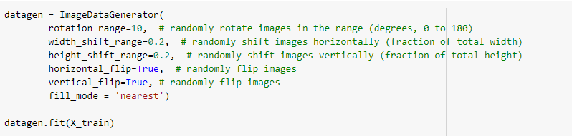
Data Augmentation
Images in train set are augmented again to increase training samples and increase robustness

Slide 21
Training
Pre-trained CNN Architectures
VGG16
InceptionV3
Xception
Inception-ResNet-V2
DenseNet121
DenseNet169
DenseNet201

Slide 22
Proposed Technique
Ensemble of top 4 fine-tuned pre-trained CNN network architectures
Xception Inception-ResNet-V2, DenseNet121 and Densenet201
Ensemble technique: Stacking
Stacking: Modified averaging ensemble, involving re-training of the combined trained sub-models
Reduces high variance and improves predictions on test data

Slide 23
Block Diagram of Proposed Methodology

Slide 24
Fine-tune pre-trained Xception Network

Slide 25
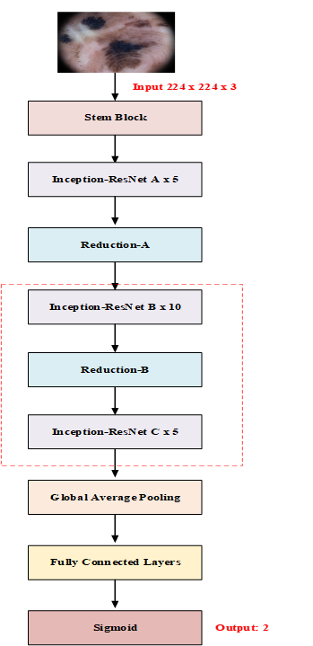
Fine-tune pre-trained Inception-Resnet-V2 Network

Slide 26
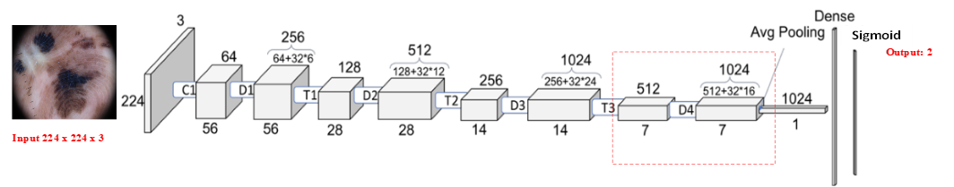
Fine-tune pre-trained DenseNet121 and DenseNet201

Slide 27
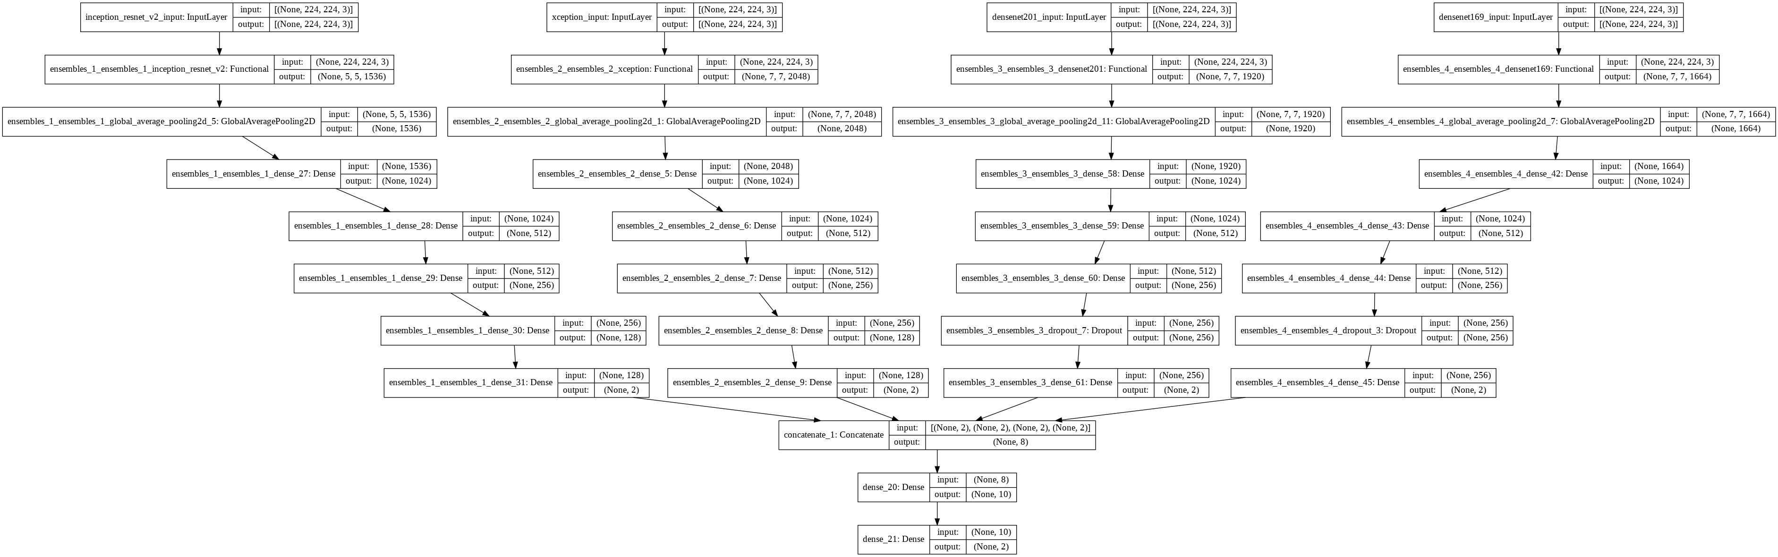
Stacked Ensemble Architecture

Slide 28
RESULTS AND ANALYSIS
4

Slide 29
Hyper-parameters Settings
Hyper-parameters Settings
Hyper-parameter | Parameter Value
Optimizer | Adam
Learning Rate | 0.0001
Loss Function | binary_crossentropy

Slide 30
Performance Comparison of Pre-trained
Models with and without Data Augmentation
Results without Data Augmentation
Pre-trained Model | Validation accuracy | Test Accuracy
VGG16 | 91.03% | 91.72%
InceptionV3 | 87.59% | 87.85%
Xception | 90.34% | 90.34%
InceptionResnetV2 | 91.72% | 91.72%
DenseNet121 | 91.72% | 91.72%
Results with Data Augmentation
Pre-trained Model | Validation Accuracy | Test Accuracy
VGG16 | 91.03% | 91.03%
InceptionV3 | 93.10% | 93.10%
Xception | 95.17% | 95.17%
InceptionResnetV2 | 95.17% | 95.17%
DenseNet121 | 94.48% | 94.48%
DenseNet169 | 94.48% | 94.48%
DenseNet210 | 95.86% | 95.86%

Slide 31
Performance of Top 4 Fine-tuned Models and their Ensemble
Models | Epochs | Training accuracy | Validation accuracy | Test accuracy
Xception | 25 | 100% | 95.17% | 95.17%
Inception-ResNet-V2 | 50 | 98.90% | 95.17% | 95.17%
DenseNet121 | 50 | 94.92% | 94.48% | 94.48%
DenseNet201 | 45 | 99.82% | 95.86% | 95.86%
Combined stacked ensemble model | 10 | 100% | 100% | 97.90%

Slide 32
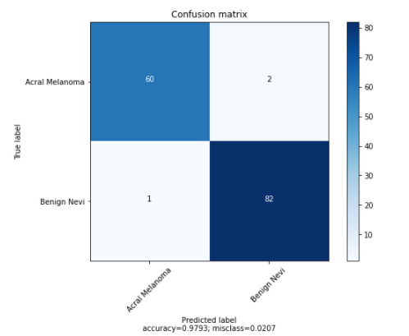
Confusion Matrix

Slide 33
Experimental Results (Cont.)
Class | Precision | Recall | F1-score | Sensitivity | Specificity | Accuracy
Acral Melanoma | 98% | 97% | 98% | 97% | 98% | 96.77%
Benign Nevi | 98% | 99% | 98% | 98.63% | 97% | 98.79%

Slide 34
Performance Analysis
Related Work | Technique | Results
C. Yu et al [1] | Data Augmentation and Transfer Learning Using Pre-trained VGG16 | Accuracy : 80.3% Sensitivity : 92% Specificity : 75%
S. Lee et al [2] | Transfer Learning using Pre-trained ResNet50 | Accuracy : 83.51%
J. A. A [3] | Transfer Learning using Pre-trained AlexNet | With Hair Removal Accuracy : 92.5% Sensitivity : 90% Specificity : 90% Without Hair Removal Accuracy : 82.5% Sensitivity : 74% Specificity : 74%
Proposed Model | Stacking ensemble of fine-tuned Xception Inception-ResNet-V2, DenseNet121 and DenseNet201 | Accuracy : 97.93% Sensitivity : 97.83% Specificity : 97.50%

Slide 35
Main Findings
Finding 01
Finding 02
Selection of Suitable Pre-trained Models and Hyper-parameters are crucial and requires experimentations
Data Augmentation plays a vital role on the performance of trained models
Finding 03
Finding 04
The model tends to overfit incase of more unfreezing of layers
Performance of trained models is significantly improved using Ensemble

Slide 36
Conclusion
Proposed Ensemble of Fine-tuned Pre-trained CNN Architectures performs very well in detecting Acral Lentiginous Melanoma and Benign Nevi with Test Accuracy of 97.93%

Slide 37
References
[1] C. Yu et al., “Acral melanoma detection using a convolutional neural network for dermoscopy images,” PLoS One,
[2] S. Lee et al., “Augmented decision-making for acral lentiginous melanoma detection using deep convolutional neural networks,” J. Eur. Acad. Dermatology Venereol., vol. 34, no. 8, pp. 1842–1850, 2020, doi: 10.1111/jdv.16185
[3] J. A. A. Salido and C. Ruiz, “Using deep learning for melanoma detection in dermoscopy images,” Int. J. Mach. Learn. Comput., vol. 8, no. 1, pp. 61–68, 2018, doi: 10.18178/ijmlc.2018.8.1.664.
[4] https://figshare.com/s/a8c22c09f999f60a81bd

Slide 38

Demonstration

Slide 39


